Slide 1
Permutation test

Slide 2
Sample of abstract table
CATEGORY | VALUE
A | 10
B | 12
B | 11.5
A | 11
A | 9
B | 11
A | 9.5
B | 10.5
B | 9.5
B | 10.5

Slide 3
Group A or Group B?
Which one has higher mean(Val)?

Slide 4
Permutation test – alternative to z-test
Just scramble (permute) the column A
Run these permutations N times
See how does mean(A, VAL) – mean(B, VAL) behave?

Slide 5
Permutation (one)
CATEGORY | VALUE
A-> B | 10
B -> A | 12
B -> B | 11.5
A-> B | 11
A-> A | 9
B-> A | 11
A -> B | 9.5
B -> A | 10.5
B-> B | 9.5
B-> B | 10.5

Slide 6
Permutation test: Do it 1000s of times….
Permute (scramble data) 1000,10000 times…and observe what *random* does?
How do random differences of means(VAL) distribute?

Slide 7
Code for “nice example’ (see data101 site)
Cat1<-rep("GroupA",10) Cat2<-rep("GroupB",10) Cat<-c(Cat1,Cat2)
Val1<-rnorm(10,mean=25, sd=10
Val2<-rnorm(10,mean=30, sd=10)
d<-data.frame(Cat,Val)
Observed_Difference< mean(d[d$Cat=='GroupA',2])mean(d[d$Cat=='GroupB',2])

Slide 8
PermutationTestSecond::Permutation(d, "Cat", "Val",10000, "GroupA", "GroupB")

Slide 9
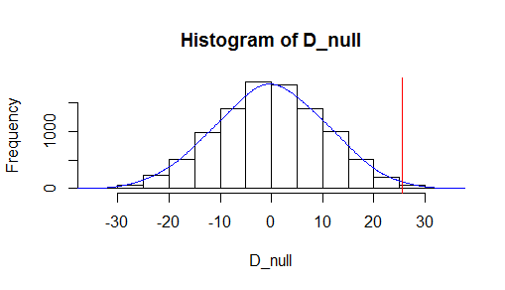
Mean 25 vs mean 30, sd=10 vs sd=30, p<0.01

Slide 10
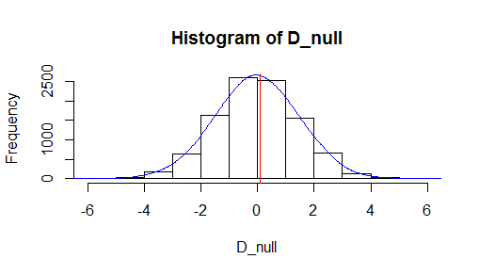
MEAN=25, Mean =28 sd=10; p=0.46

Slide 11
Install our own permutation function
install.packages("devtools")
devtools::install_github("devanshagr/PermutationTestSecond")
devtools::install_github("devanshagr/PermutationTestManual")

Slide 12
One step vs MANY STEPS
PermutationTestManual::permute_test(read.csv('https://raw.githubusercontent.com/kunal0895/RDatasets/master/TRAFFIC.csv'), "TUNNEL", "VOLUME_PER_MINUTE", "Holland", "Lincoln")
PermutationTestSecond::Permutation(TRAFFIC, "TUNNEL", "VOLUME_PER_MINUTE",1000,"Holland", "Lincoln")

Slide 13
Other data sets
Select CAT variable like say “Text in class”
Select two values (say “always”, “never”)
Measure Mean(score) is it affected by texting?
PermutationTestSecond::Permutation(Moody, “Text_in_class", “SCORE",1000,“always", “never")

Slide 14
What else?
CAT = ‘Grade’
VAL = ‘SCORE’
CAT = ‘text in nclass’
GRADE -> convert to numerical (1-5)!

Slide 15
Permutation test
Blind to distribution
Apply to any data, groups defined by categorical attribute (like tunnels) and difference of means applied to numerical attribute
Run 10,000 times using our permutation function (data101 site)

